Slide 1
LECTURE 5
Input/Output Organization (Cont)

Slide 2
INPUT/OUTPUT ORGANIZATION
Processor
Memory
BUS
I/O device 1
……
I/O device n
Multiple I/O devices may be connected to the processor and the memory via a bus.
Bus consists of three sets of lines to carry address, data and control signals.
Each I/O device is assigned an unique address.
To access an I/O device, the processor places the address on the address lines.
The device recognizes the address, and responds to the control signals.

Slide 3
I/O INTERFACE
Address Lines
Data Lines
Bus
Control Lines
Address
Decoder
Control
Circuit
Data and
Status Registers
I/O Device
Move R0,DATAIN
Move DATAOUT,R0

Slide 4
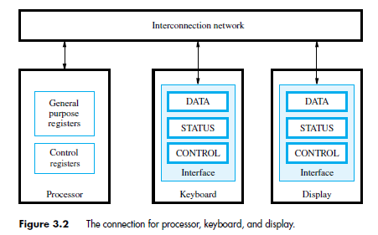
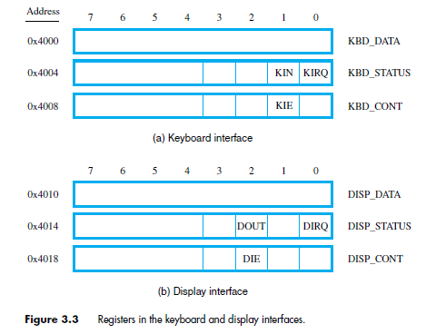
KIN : Keyboard Input
KIE : Keyboard Interrupt Enable
KIRQ : Keyboard Interrupt Request
DOUT : Display output
DIE : Display Interrupt Enable
DIRQ : Display Interrupt Request

Slide 5
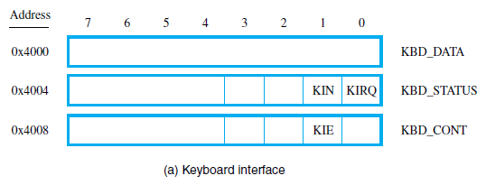
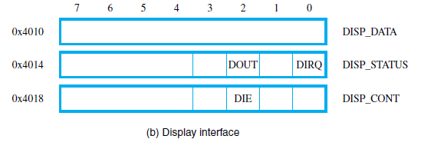
Basic Operation of Input,Output
In the beginning KIN=0 and DOUT=1
For the keyboard, KIN=0 means keyboard is ready. When data is in, KIN is Set (KIN=1) and as long as KIN=1 keyboard can not accept new data.
In the CPU side, KIN=0 means there is no data in the keyboard. If KIN=1 the data will be transferred to register and KIN is Reset (KIN=0).
How about the Display?

Slide 6
READWAIT Read the KIN ﬂag
Branch to READWAIT if KIN=0
Transfer data from KBD_DATA to R5
READWAIT: LoadByte R4, KBD_STATUS
And R4, R4, #2
Branch_if_[R4]=0 READWAIT LoadByte R5, KBD_DATA
WRITEWAIT Read the DOUT ﬂag
Branch to WRITEWAIT if DOUT=0
Transfer data from R5 to DISP_DATA
WRITEWAIT: LoadByte R4, DISP_STATUS
And R4, R4, #4
Branch_if_[R4]=0 WRITEWAIT StoreByte R5, DISP_DATA

Slide 7
Example I/O program (RISC)
Move R2, #LOC
MoveByte R3, #CR
READ: LoadByte R4, KBD_STATUS
And R4, R4, #2
Branch_if_[R4]=0 READ
LoadByte R5, KBD_DATA
StoreByte R5, (R2)
Add R2, R2, #1.
ECHO: LoadByte R4, DISP_STATUS
And R4, R4, #4
Branch_if_[R4]=0 ECHO
StoreByte R5, DISP_DATA
Branch_if_[R5] ≠ [R3] READ

Slide 8
Example I/O program (CISC)
Move R2, #LOC
READ: TestBit KBD_STATUS, #1
Branch=0 READ
MoveByte (R2), KBD_DATA
ECHO: TestBit DISP_STATUS, #2
Branch=0 ECHO
MoveByte DISP_DATA, (R2)
CompareByte (R2)+, #CR
Branch ≠ 0 READ

Slide 9
Input Output Techniques
Program Controled I/O
Interrupt driven
Direct Memory Access (DMA)

Slide 10
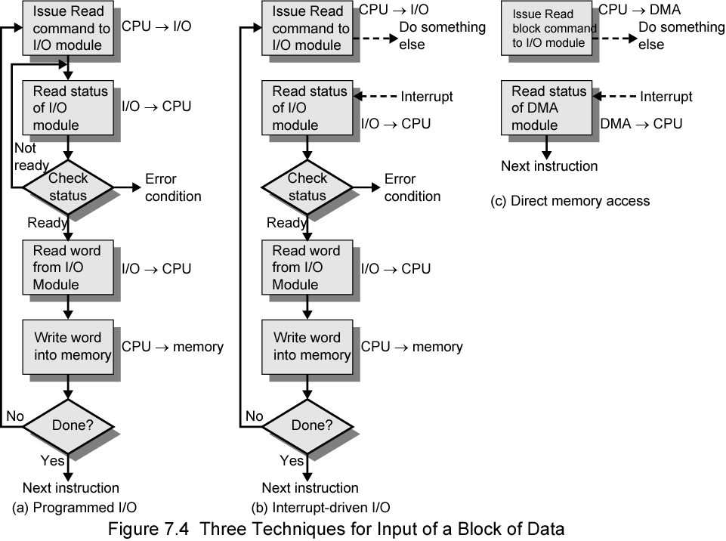
Three ways to input block of data

Slide 11
Program Controlled I/O
CPU directly controls the I/O device.
  Check status
  Issue Read/write
  Transfer data
CPU waits the I/O device to finish the operation
Waste time of CPU
The example of previous I/O program is
Program Controlled I/O

Slide 12
INTERRUPT
In Program Controlled I/O, a lot of CPU time is wasted only to check whether I/O is ready or not.
In order for CPU to do other process, the I/O unit can give signal to CPU when it is ready.
This can be done by sending hardware signal called interrupt.

Slide 13
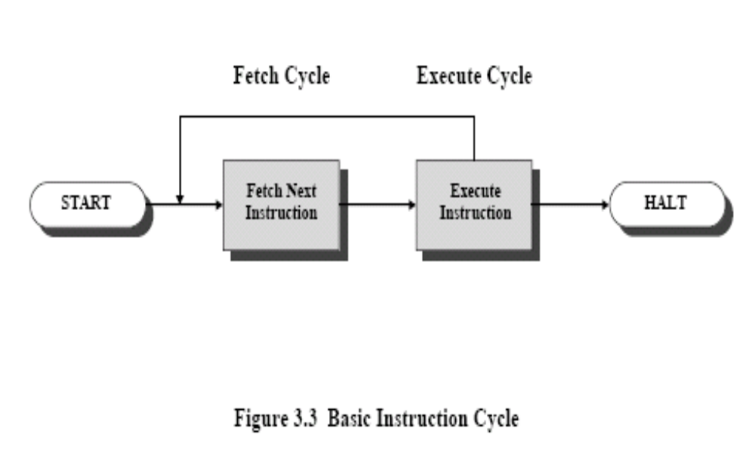
Execution cycle

Slide 14
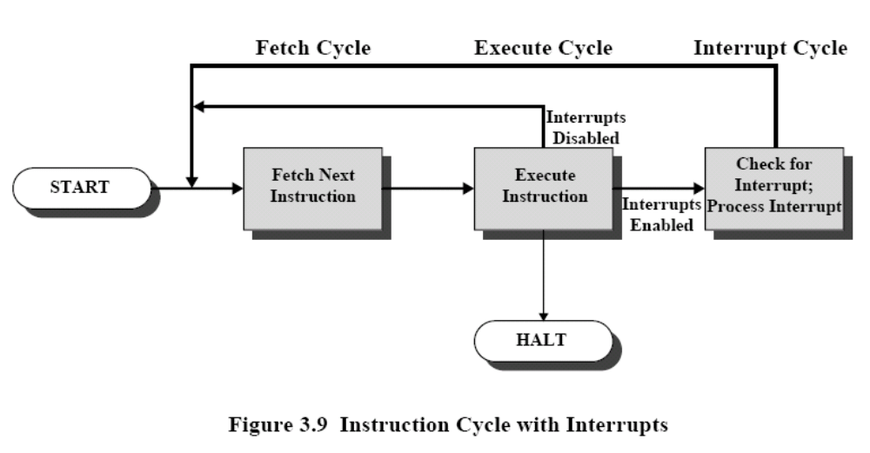
Execution cycle with interrupt

Slide 15
Interrupt Driven I/O
Overcomes CPU waiting
No repeated CPU checking of device
I/O module interrupts when ready

Slide 16
Interrupt Driven I/O Basic Operation
CPU issues read command
I/O module gets data from peripheral whilst CPU does other work
I/O module interrupts CPU
CPU requests data
I/O module transfers data

Slide 17
CPU Viewpoint
Issue read command
Do other work
Check for interrupt at end of each instruction cycle
If interrupted:-
  Save context (registers)
  Process interrupt
    Fetch data & store

Slide 18
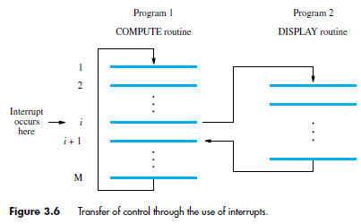
INTERRUPT

Slide 19
HARDWARE INTERRUPT
+Vdd
Processor
INTR 1
INTR 2
INTR n

Slide 20
PRIORITY INTERRUPT
Processor
INTR Request
Priority circuit
Device 1
Device 2
……
Device p
INTR Acknowledge

Slide 21
DAISY CHAIN
Processor
INTR
Device 1
Device 2
Device n
INTA
What if Priority & Daisy Chain are coupled?

Slide 22
Direct Memory Access (DMA)
Interrupt driven and programmed I/O require active CPU intervention
  Transfer rate is limited
  CPU is tied up
DMA is the answer
DMA Function
  Additional Module (hardware) on bus
  DMA controller takes over from CPU for I/O

Slide 23
DIRECT MEMORY ACCESS (DMA)
PROCESSOR
Main memory
Disk/DMA controller
DMA controller
Printer
Keyboard
Disk
Disk
Network interface

Slide 24
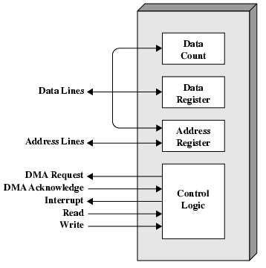
Typical DMA Module Diagram

Slide 25
DMA Operation
CPU tells DMA controller:-
  Read/Write
  Device address
  Starting address of memory block for data
  Amount of data to be transferred
CPU carries on with other work
DMA controller deals with transfer
DMA controller sends interrupt when finished

Slide 26
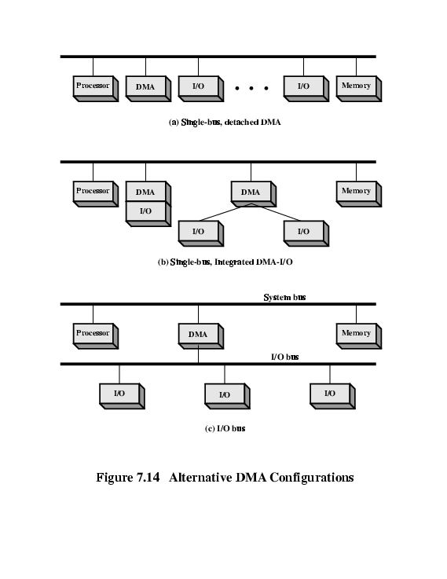
DMA Configurations (1)
Single Bus, Detached DMA controller
Each transfer uses bus twice
  I/O to DMA then DMA to memory
CPU is suspended twice

Slide 27
DMA Configurations (2)
Single Bus, Integrated DMA controller
Controller may support >1 device
Each transfer uses bus once
  DMA to memory
CPU is suspended once

Slide 28
DMA Configurations (3)
Separate I/O Bus
Bus supports all DMA enabled devices
Each transfer uses bus once
  DMA to memory
CPU is suspended once

Slide 29
HOMEWORK
Read again Chapter 4 reference 1.
Do problems 4.3; 4.4; 4.5 and 4.6
Find description of USB in internet and make resume.

